Slide 1
Job Hunting
The Data Science of Scraping Job Reqs, Predicting the Minimum Requirements Section, and Predicting whether you Qualify

Slide 2
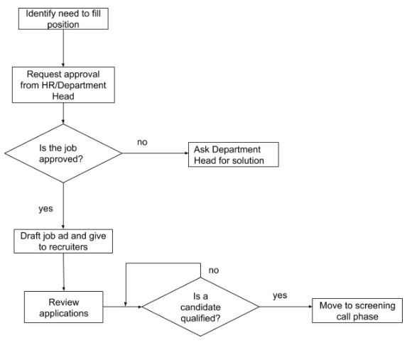
Typical Job Hunting Problems
Filling internal openings
Checking Labor Category Requirements against an internal resume repository
Checking if you qualify for job postings in an Open Requisitions Report (ORR)

Slide 3
Data Sources
Resumes
Job Postings
Labor Category Requirements
From a Statement of Work
From a Business Development Proposal

Slide 4
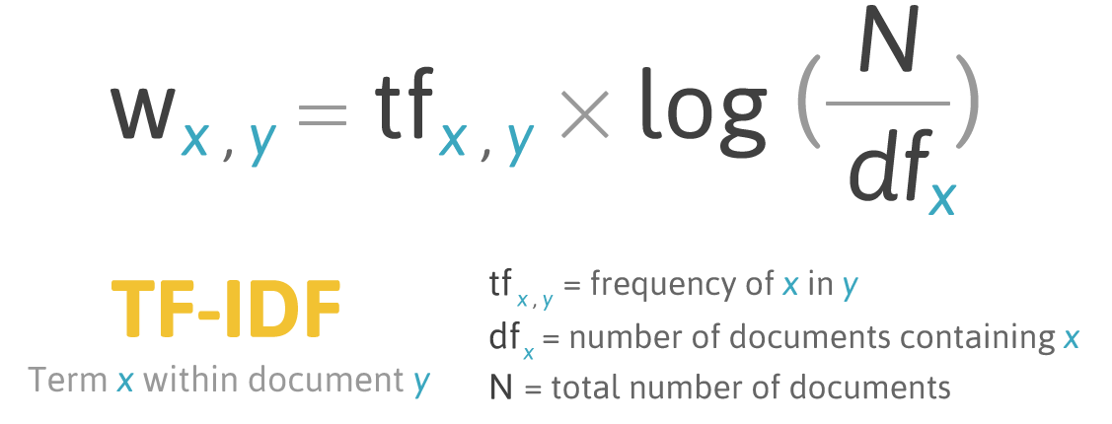
Feature Extraction
No removing of stop words – “or” & “and” are important distinctions
text => Bag of Words (BOW) => Term Frequency–Inverse Document Frequency (TF-IDF)
BOW is tokenized to separate punctuation yet keep symbol prefixes and suffixes attached (.NET, C++, C#, etc.)
TF-IDF is used as a weighing factor to reflect how important or distinct a word is

Slide 5
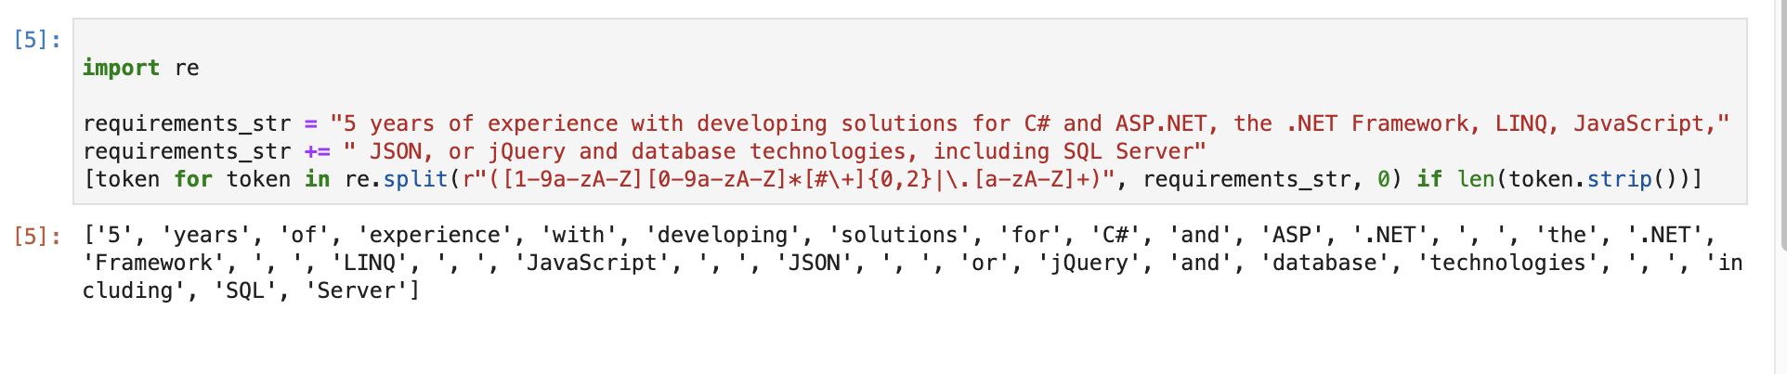
Tokenization, continued
"5 years of experience with developing solutions for C# and ASP.NET, the .NET Framework, LINQ, JavaScript, JSON, or jQuery and database technologies, including SQL Server"
([1-9a-zA-Z][0-9a-zA-Z]*[#\+]{0,2}|\.[a-zA-Z]+)

Slide 6
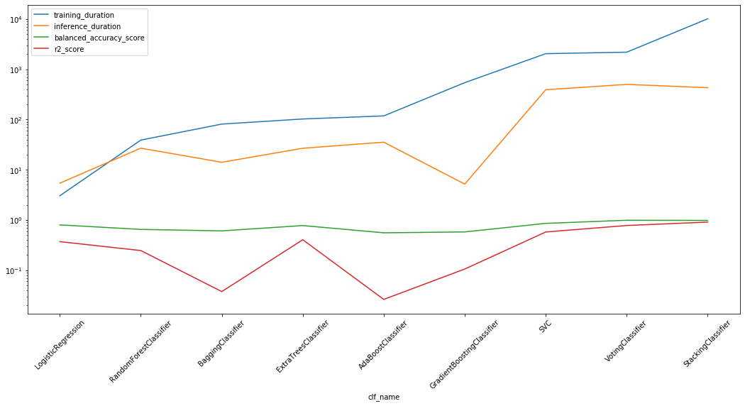
Model Building
These algorithms are tested for accuracy (medium to high), training duration (low to medium), and inference duration (low):
Many algorithms have been fit to this data:
Classifiers:
AdaBoost Classifier,
Bagging Classifier,
Extra Trees Classifier,
Gradient Boosting Classifier,
Random Forest Classifier,
Logistic Regression,
SVC, etc.
Conditional Random Fields (CRFs)
Appearance-based Approaches:
Latent Dirichlet Allocation (LDA)
Latent Semantic Analysis (LSA)

Slide 7
Classifier Models
Does the user meet this particular qualification?
Tag Text in HTML Job Posting (Header? Non-header?)
Task Scope
Required/Basic/Minimum Qualifications
Preferred/”Nice to Have” Qualifications
Legal Notifications
Job Title
Office Location
Job Duration
Supplemental Pay
Education Requirements
Interview Procedures
Corporate Scope
Post Date

Slide 8
Classifier Models, continued
Tag Set Inclusion of HTML Tags:
Document structure elements
Document head elements
Document body elements
Block elements
Basic text
Section headings
Lists, etc.

Slide 9
CRF Features
Part-of-Posting prediction (Job Title, Task Scope, etc.)
Navigable text sequence positional information
HTML Tag information (if text is surrounded by HTML tags)
Information about its neighbors

Slide 10
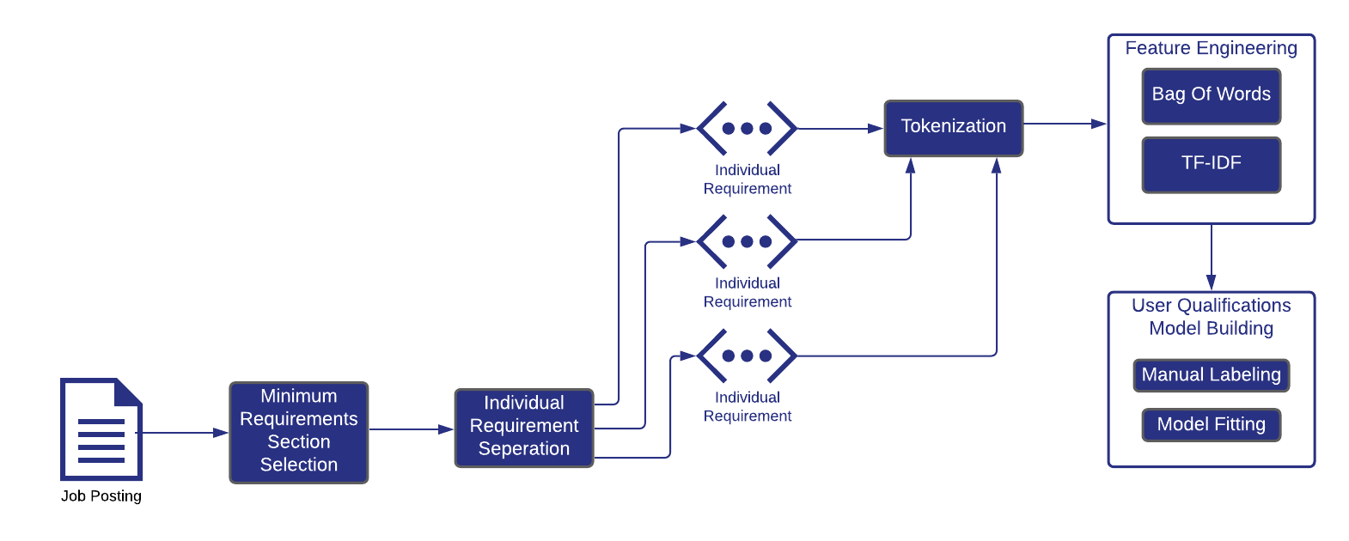
Job Post User Qualifications Model Training

Slide 11
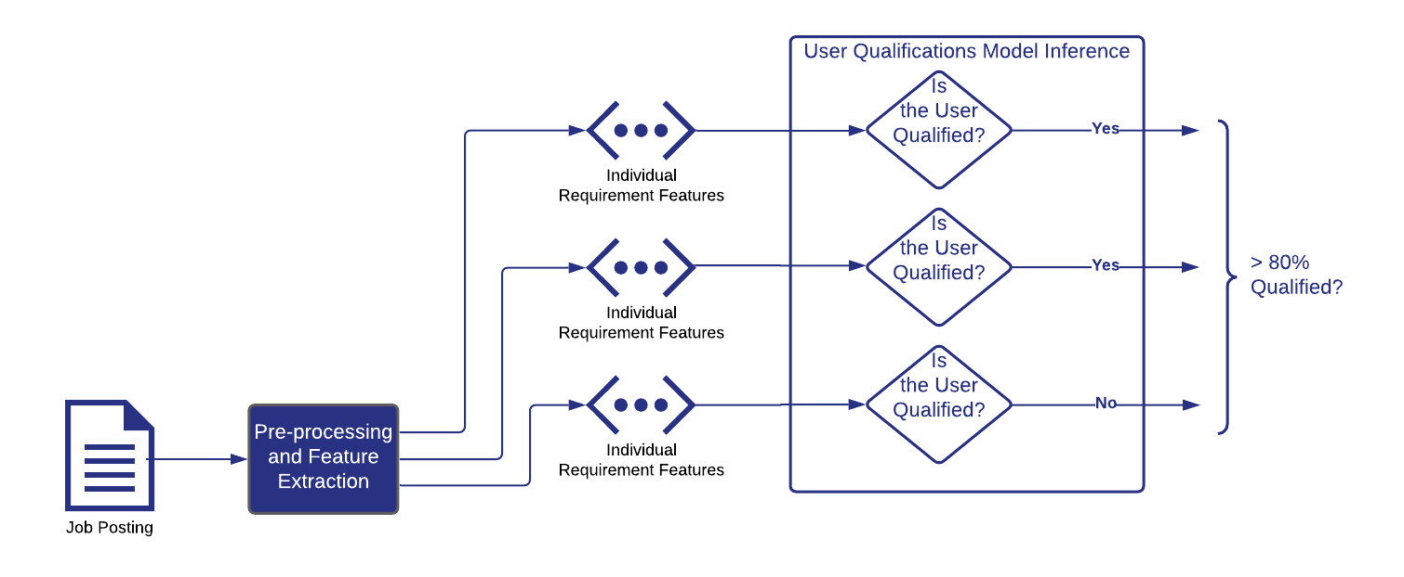
Job Post User Qualifications Model Inference

Slide 12
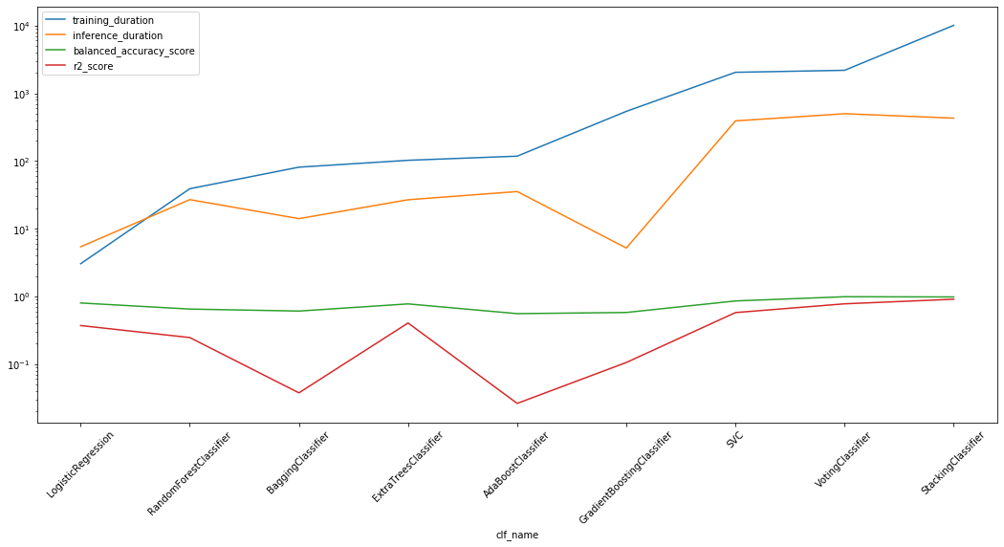
Duration Measures and Accuracy Measures

Slide 13
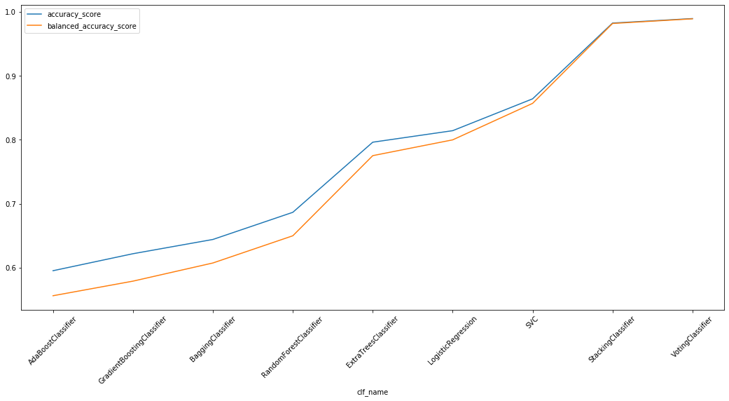
Other Accuracy Measures

Slide 14
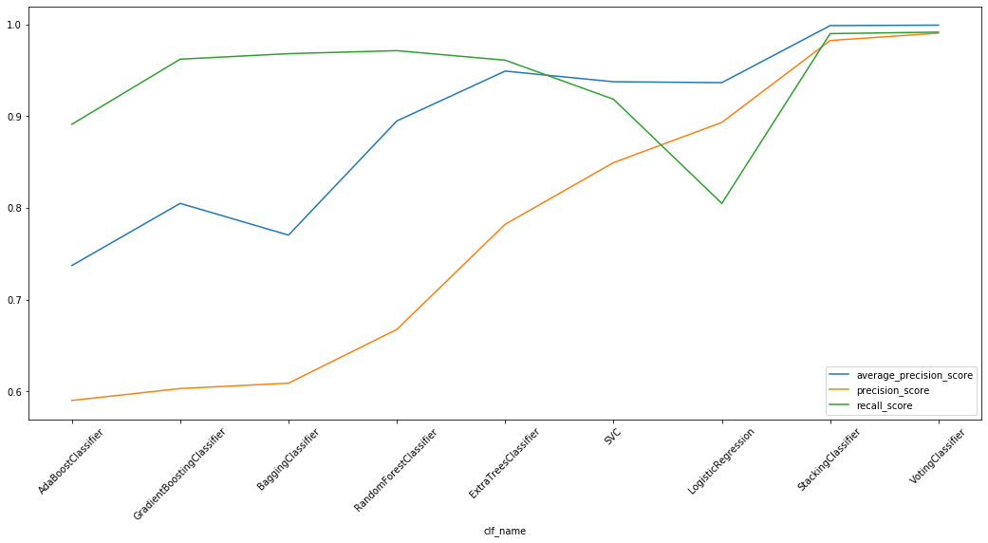
Precision and Recall

Slide 15
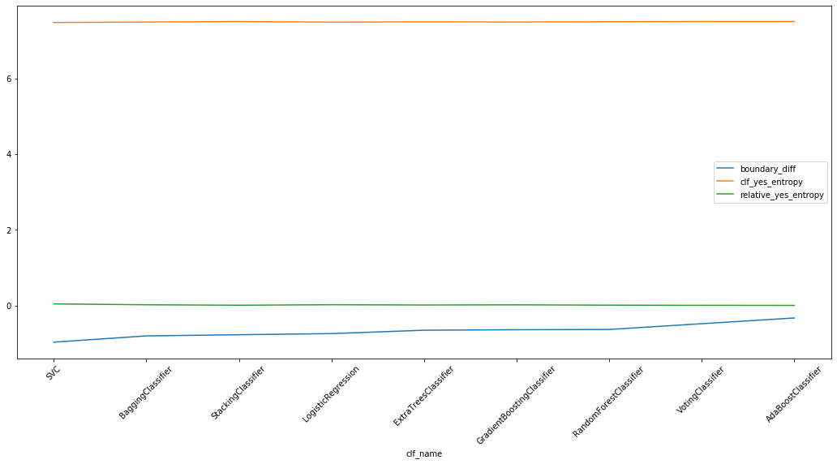
Junk Entropy Measures

Slide 16
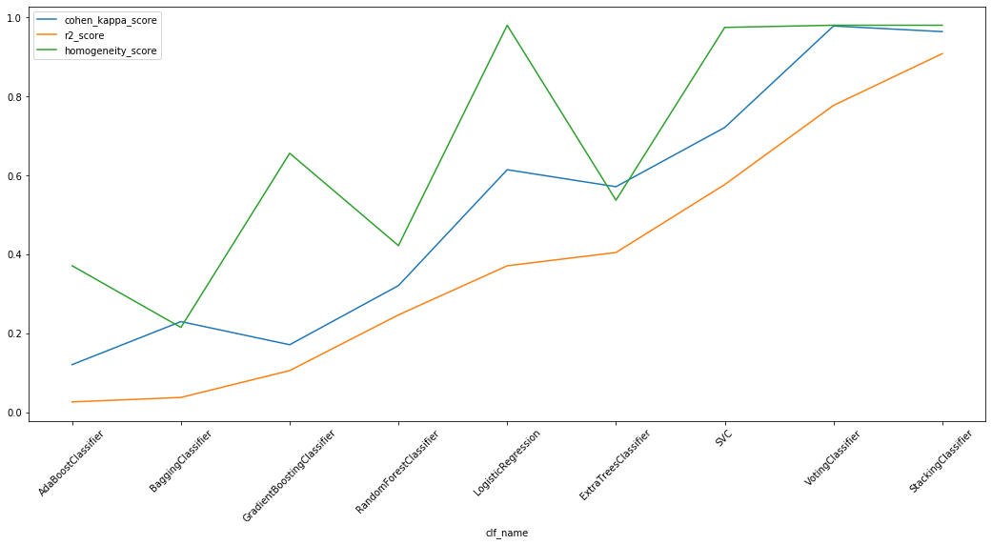
Coefficient of Determination and Other Hypothesis Testing Measures

Slide 17
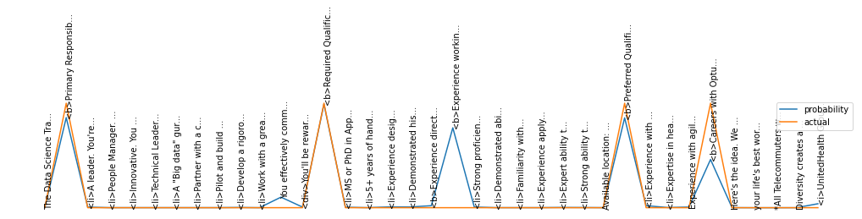
Named Entity Recognition (NER) System with Header Pattern Data

Slide 18
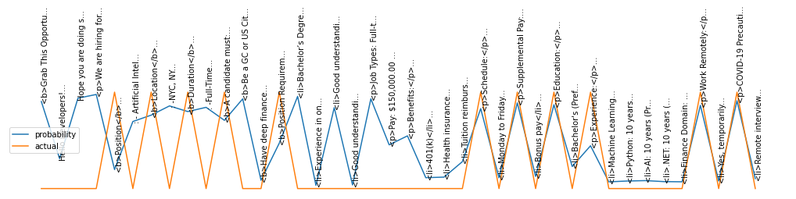
Indeed.com Sequence Analysis (Checking for Headers)

Slide 19
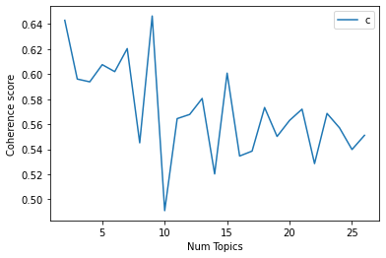
LDA Coherence by Number of Topics

Slide 20
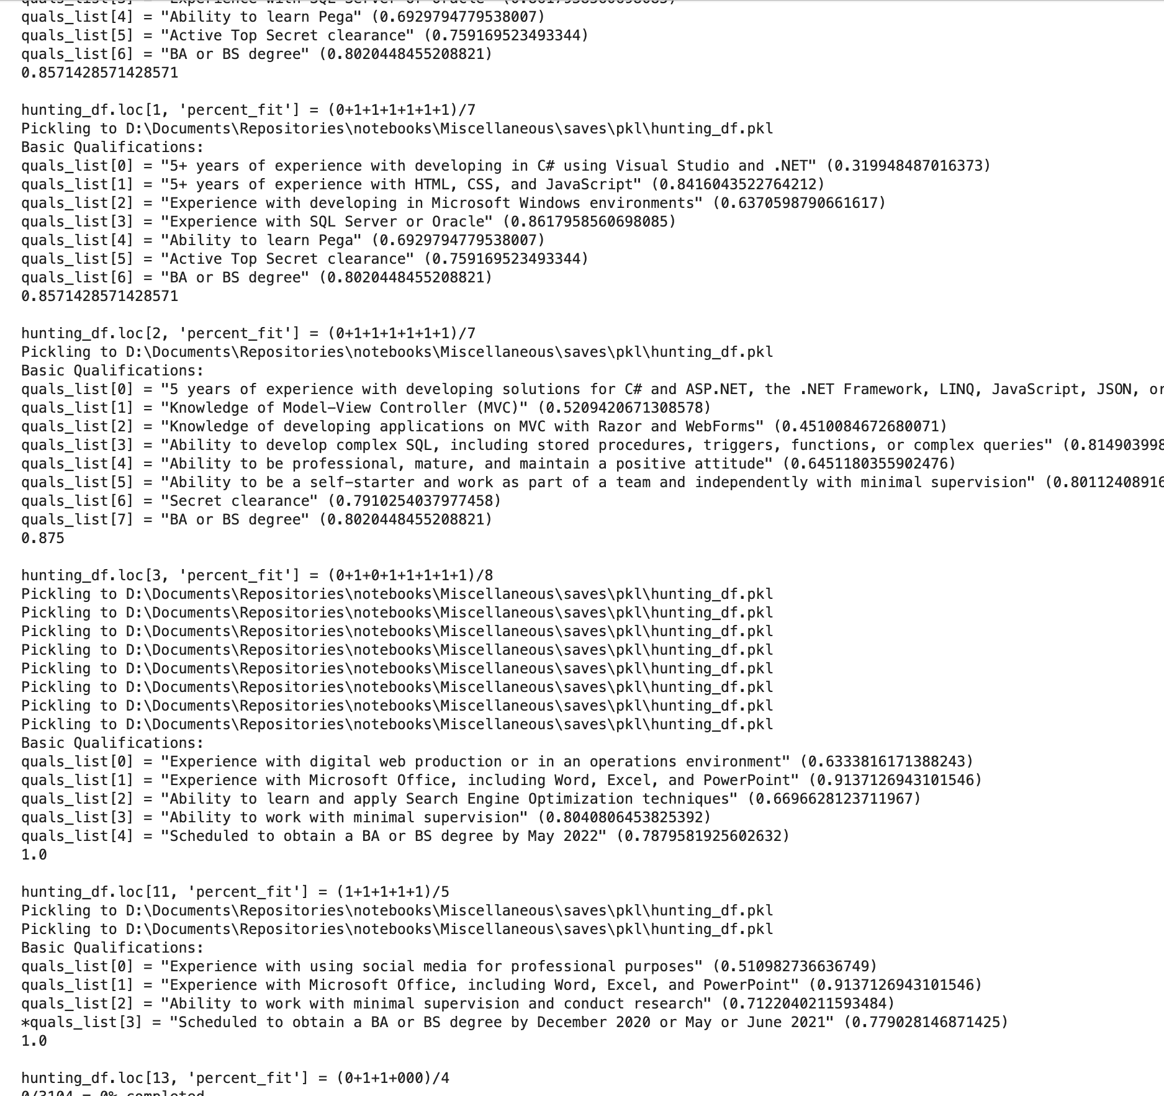
Demo

Slide 21

Questions?

